Slide 1
COFFEE SHOP
DHINESH KUMAR S
MOHAMED ATHAM S
RAJKUMAR K V

Slide 2
AGENDA
Abstract
Problem Statement
Proposed Solution
System Architecture
Output Screenshots
Analysis and Findings
Conclusion
References

Slide 3
Abstract
We have a website for ordering coffee as part of our initiative.
He or she is able to continue ordering coffee for the day by using this website. The user must place an order with item quantities by selecting "Coffee Order," which causes the system to present a list of available coffee and snacks. He or she then moves on to Payment methods and Order confirmation.
The Angular platform was used to construct this project. To access the information firebase Authentication service was used.

Slide 4
Problem Statement
Customers find it exhausting to order their coffee, wait for it, and then consume it amid their hectic schedules, according to the analysis. Our morning beverage should be easily accessible. Therefore, having a website that can perform this task for visitors is quite important in our day-to-day lives.

Slide 5
Proposed Solution
Our website brings modern method for saving time with Dine In and takeaway options. Customers doesn't need to wait in a long queue and can go through cashless payment system by using PayPal.

Slide 6
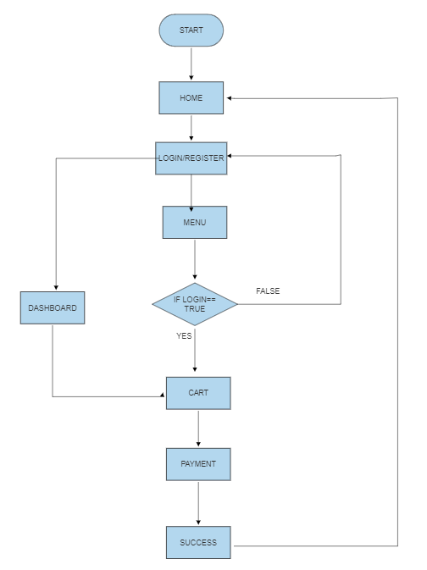
System Architecture

Slide 7
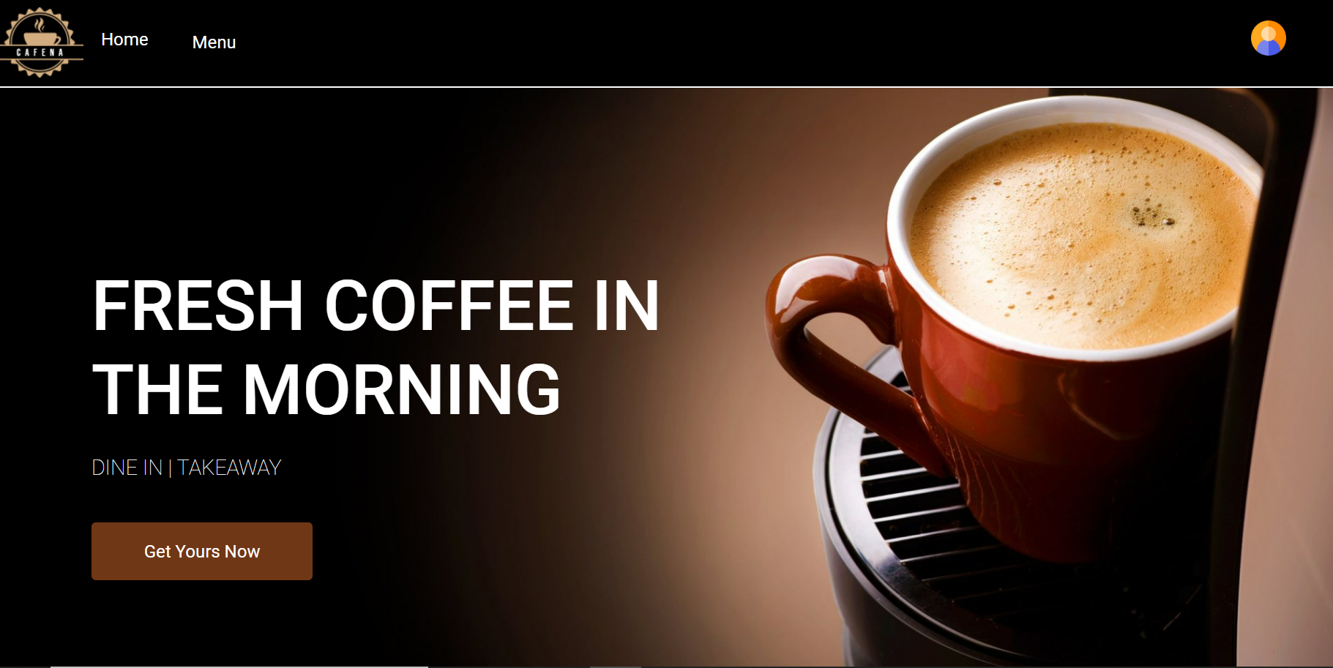
Screenshot

Slide 8
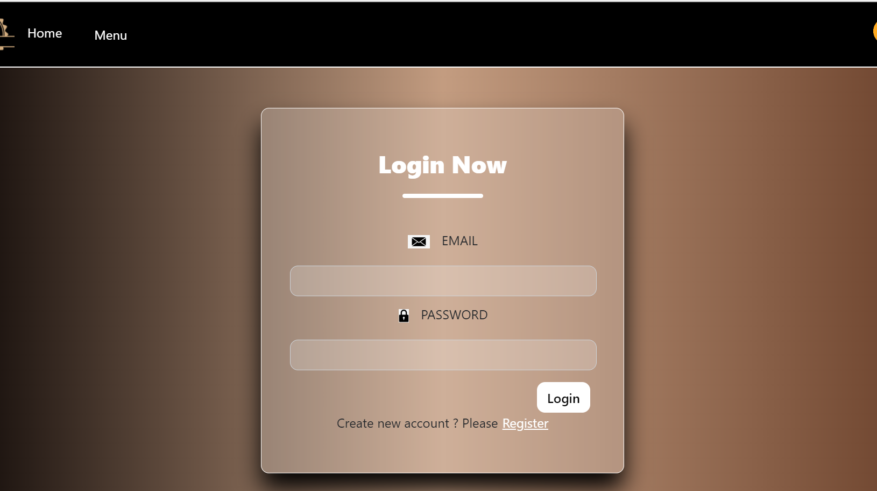

Slide 9
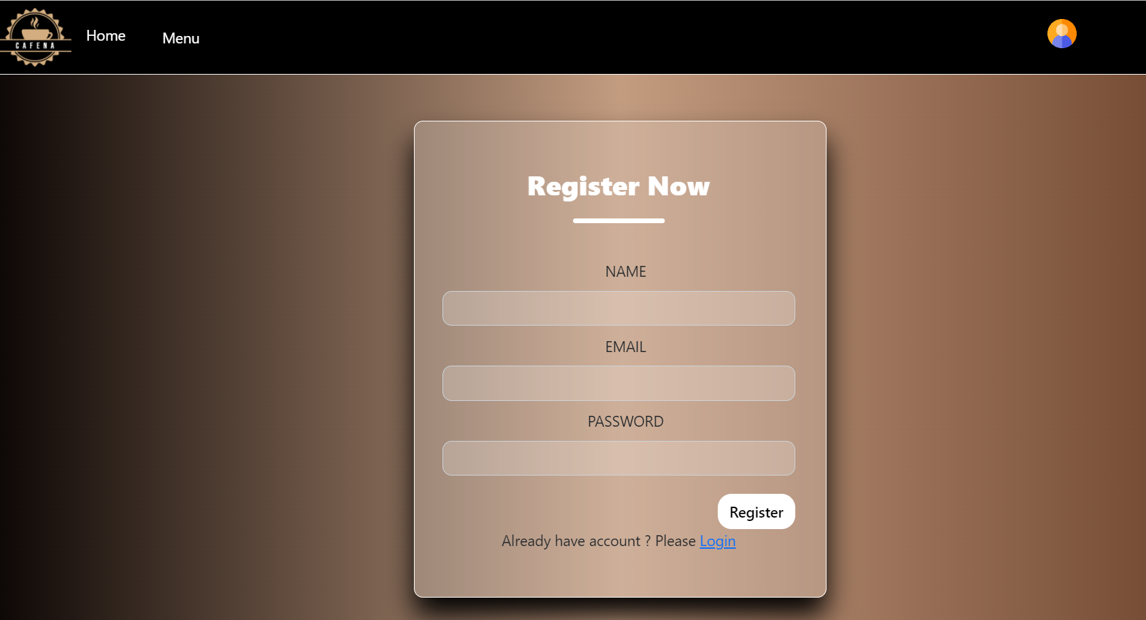

Slide 10
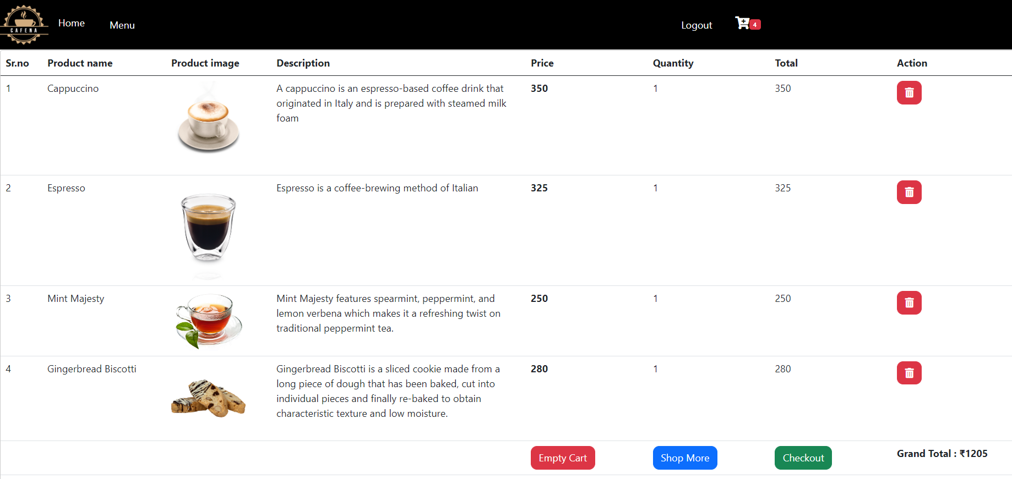

Slide 11
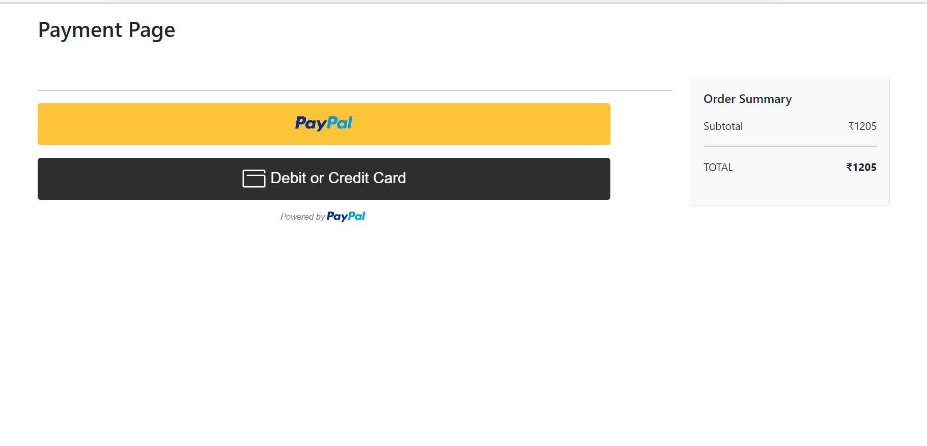

Slide 12
Github link
https://github.com/Dhineshkumar11/coffee-shop.git

Slide 13
Analysis and Findings:
Angular CRUD Operations
PayPal Module
Pipe Module
Authentication
Validation

Slide 14
Conclusion:
This will improve the manufacturing and distribution systems' efficacy and efficiency. This will improve service quality, saving customers' time and energy.

Slide 15
THANK YOU

